Slide 1

Week 3 Artifacts
Team My Lil' HealthBot

Slide 2
Actor: University/ College students in North America
Method: User Interface on Touch Screen + Machine + ChatBot
Activities: Retailing + Customer Service + Sales +Database
Input:
Tap Keyword + Icon
Gamifciation
App
Sensors
New Wedge:
Privacy
Avatar
Technology:
Robotic Calculation
Automatic Replenishment
Cashless Transaction
Storage
Traffic Monitoring
Output:
Healthcare + Personal care Product
Delivery Platform
system diagram
*Updates to system diagram is highlighted in bold.

Slide 3
Original User Stories
1

Slide 4
User Story
Persona
Tom is a 19 year old engineering undergrad at Cornell University
Lives on campus
Hates lining up
Loves playing games
Does not know much about pharmaceutical products
User Story #1
Wedge: Use sensors to help the user make a smarter purchase
Tom is not feeling well one night, and he does not know where to purchase medicine
Tom decides to go to the student center to use “My Lil HealthBot”
After a few quick prompts, ‘My Lil HealthBot’ starts to measure Tom’s biometric data using various sensors
Based on the sensor data, ‘My Lil HealthBot’ performs a quick analysis and provides recommendations
Tom receives the product he selected

Slide 5
User Story #2
Wedge: Broadcast the retailer interface to mobile devices to expedite purchases
Tom has a headache and wants to buy Tylenol
He goes to My Lil HealthBot in the student center to make a purchase
Tom is surprised to find a queue waiting to use ‘My Lil HealthBot’
‘My Lil HealthBot’ has a built-in wireless device that allows the users to access the machine interface through his or her phone
Tom makes the purchase through his phone
After a couple of minutes, Tom receives a notification and picks up the product from the machine
User Story #3
Wedge: Help deliver products using the university’s social and technological infrastructure
Tom is not feeling well , and he is too sick to go use ‘My Lil HealthBot,’ which is in the student center
Tom opens up a mobile app and selects the medication he needs
The payment is charged directly to his Cornell bursar account
The app also matches him to another student, Lily
Lily will help deliver Tom’s items since she lives in his vicinity
Tom gets an estimated time of arrival from Lily and receives a notification when Lily has arrived at his dorm

Slide 6
Updated User Stories
2

Slide 7
New User Stories
User Story #1(Updated)
Wedge: Use sensors and smart UI to help the user make a smarter purchase
Tom is not feeling well one night, and he does not know where to purchase medicine
Tom decides to go to the student center to use “My Lil HealthBot”
Based on his profile and symptoms, “My Lil HealthBot” lists the hottest Top 10 products for him.
After a few quick prompts, ‘My Lil HealthBot’ starts to measure Tom’s biometric data using various sensors
When waiting for result, Tom could utilize force sensor and camera to play “flappy bird” on the UI; discount will be given if Tom win the game.
Based on the sensor data, ‘My Lil HealthBot’ performs a quick analysis and provides recommendations
Tom receives the product he selected
Tom has the ability to rate the product he bought last time.

Slide 8
User Story #2(Updated)
Wedge: Broadcast the retailer interface to mobile devices to expedite purchases
Tom has a headache and wants to buy Tylenol
He goes to My Lil HealthBot in the student center to make a purchase
Tom is surprised to find a queue waiting to use ‘My Lil HealthBot’, so Tom operated on his mobile app which had the projection of UI.
Tom makes the purchase through his phone with payment of his university’s bursar account or debit/ credit card.
After a couple of minutes, Tom receives a notification and picks up the product from the machine.
User Story #3(Updated)
Wedge: Help deliver products using the university’s social and technological infrastructure or university employee
Tom is not feeling well , and he is too sick to go use ‘My Lil HealthBot,’ which is in the student center
Tom opens up a mobile app and selects the medication he needs
The payment is charged directly to his Cornell bursar account
The app also matches him to another student, Lily
Lily is a contract employee of “My Lil HealthBot” and acts more professional. She could make every delivery right on time and gives the patients some useful suggestions according to their situation.
Lily will help deliver Tom’s items since she lives in his vicinity
Tom gets an estimated time of arrival from Lily and receives a notification when Lily has arrived at his dorm

Slide 9
Narrative
+
Team Sketch Solutions
3

Slide 10
Narrative
The retailing industry has undergone seismic changes over the last decade. E-commerce giants like Amazon have radically changed the way people shop for products. Robotic retailers like “My Lil’ HealthBot” are trying to provide another channel for customers to make their purchases. It is not always convenient to go to stores to purchase OTCs or personal care products. Research have shown that customers go to the drugstores for about 75 products 90 percent of the time. They are also more likely to visit these stores when they are dire need of these products. This means a vending machine model would be perfect for this market segment. These machines are able to hold enough inventory while providing the users with instant gratification. The challenge with this business model is the lack of personalization. It is hard to maintain a loyal customer base when there is a lack of human-like interactions. Another problem is the many different channels to purchase product nowadays; it is harder more than ever to keep a customer’s attention and loyalty. Therefore, it is necessary for robotic retailers to implement another layer of smart technology to keep the customer engaged and entertained. There needs to be some emotional or physical reward to draw the user back to the machine.

Slide 11
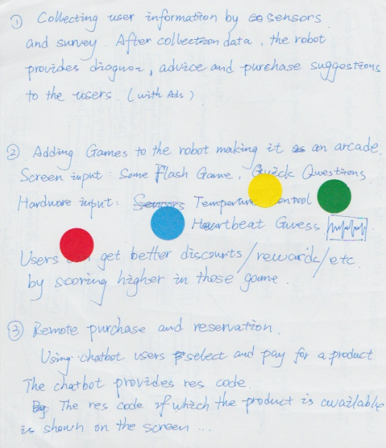
Team Sketch Solution#1
Sensors can help robotic retailers smarter and also enhance the user experience of the machine. By using nonintrusive sensors, robotic retailers can quickly measure the user’s biometric data and use it to identify the user, provide health information, and recommend products.
Sensors can also be used to create novel games that provide users with additional entertainment value by gamifying the platform. An example would be health based games that track the user’s data over different usage periods. This is a great way to differentiate the product against competitors and draw the users back to the machine. Additional benefits such as reward points for products can also be added to provide extra appeal.

Slide 12
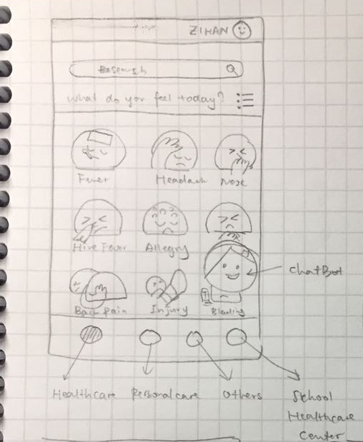
Team Sketch Solution#2
UI refinement and polishment can also help robotic retailers My Lil' HealthBot easier to use and enhance the purchasing experience for the users. Since our target audience is young university students, they might prefer the interesting and lively Icon/UI design.
We could also introduce the Avatar system to our robotic retailers My Lil' HealthBot. Using avatar to represent each symptom, the user might go through an immersive experience so that they might have more common feelings, hence it helps the university students to better understand what health status they are and what specific products they need to purchase.

